Slide 1
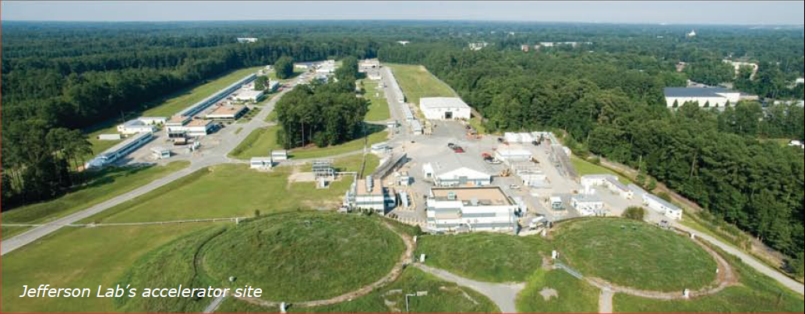
ICFA Workshop on Future Light Sources
George R. Neil
March 5, 2012

Slide 2
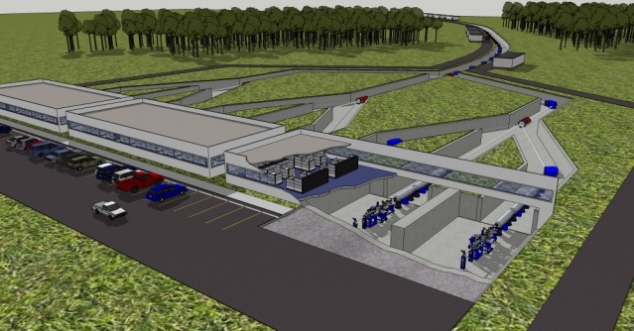
US-DOE Light Sources
Next Generation Light Source
Typically ~$100M/year operations

Slide 3
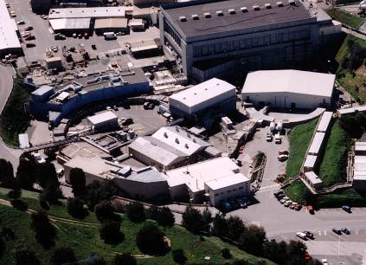
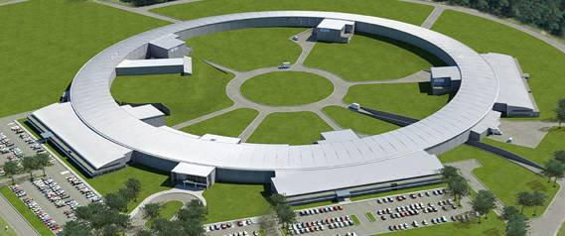
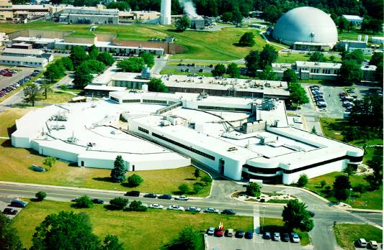
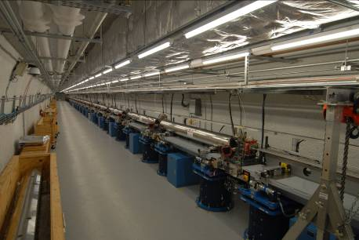
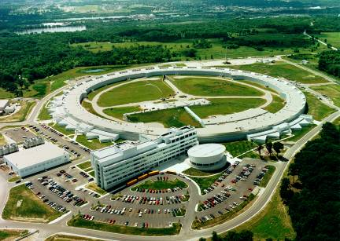
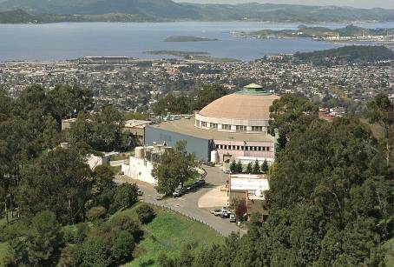
DOE Synchrotron Light Sources
NSLS-II Today
SSRL 1974 & 2004
NSLS-II 2015
NSLS 1982
APS 1996
LCLS 2009
10,000
9,000
ALS 1993
8,000
7,000
6,000
APS
Numbers of Users
ALS
5,000
SSRL
4,000
NSLS
3,000
2,000
1,000
-
82
83
84
85
86
87
88
89
90
91
92
93
94
95
96
97
98
99
00
01
02
03
04
05
06
07
08
09
10
Est.
(Harriet Kung – DOE Basic Energy Sciences)

Slide 4
BES User Facilities Hosted Over 14,000 Users in FY 2011
More than 300 companies from various sectors of the manufacturing, chemical, and pharmaceutical industries conducted research at BES scientific user facilities. Over 30 companies were Fortune 500 companies.
Courtesy: Harriet Kung

Slide 5
Opportunity
Light sources are already an important instrument for science. We have a tremendous opportunity here to develop the technologies for next generation light sources providing decades of research.
There are many interesting challenges in the physics and technology (our field) but we must not lose sight of the fact that we are working to develop a tool for users.
Getting to that end quickly, effectively, and in a cost-efficient manner is important for materials science, biology, and condensed matter researchers.

Slide 6
Announcements/Reminders
ICFA requires us to publish a conference proceedings. All oral presenters are expected to provide a paper in JACOW format Working group leaders will provide a written summary of the group’s efforts for inclusion in the proceedings. (Benson provides details)
We will keep copies of the slide presentations and will request your permission to share these with the other attendees via our website. You may refuse permission though we would prefer that you just eliminate a few slides with any sensitive information and share the rest.
A campus map is provided in your folder. All meeting rooms are in this building. We have lots of construction going on around the campus. Be aware!
Lunch will be no-host in our cafeteria. There will be a reception on Wednesday night. A list of local restaurants is provided in your folder.
Most important: Have fun, learn a lot, and, when we are finished, go home excited about the opportunity to contribute to an important field
We gratefully acknowledge the financial support of SURA/JSA for this workshop

